Slide 1

Stage 4 It’s You Call Course Designer: Chris Pukalo
It’s Your Call is a 26 round, 130 point Comstock Long course. There are 12 USPSA targets and 2 steel targets. The best two hits per target will score. Steel must fall to score. The start signal is audible.
The Handgun start position is standing inside the shooting area with toes touching marks. Handgun is loaded and holstered with wrist below top of belt. The PCC start position is standing inside the shooting area with toes touching marks. PCC is loaded with stock touching belt, muzzle pointed downrange.
On the audible start signal, engage all targets from within the shooting area.

Slide 2
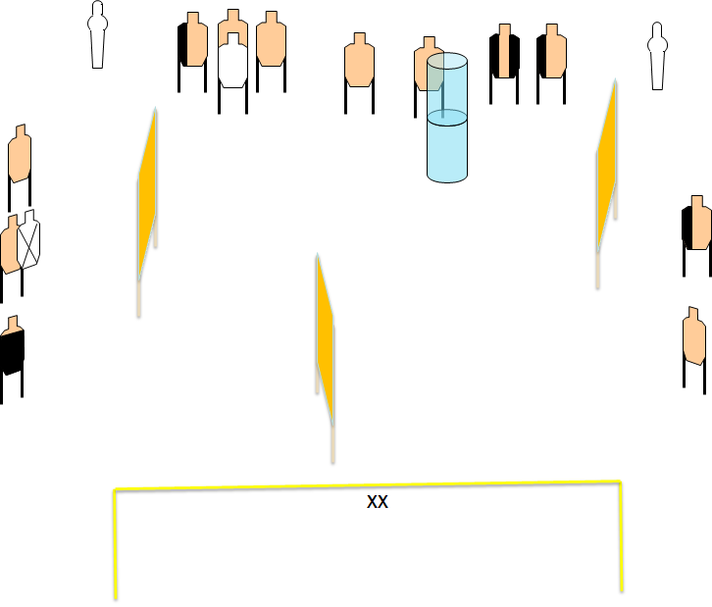
 | Renton Fish and Game Bay 4 It’s Your Call Course Designer: Chris Pukalo

